Slide 1
Arizona Yelp Data Visualization CSE 578
Spring 2020
Advisor: Dr Sharon Hsiao
Group 8
Sagar Parekh
Chetan Surana
Divya Kshatriya
Magesh Sridhar

Slide 2
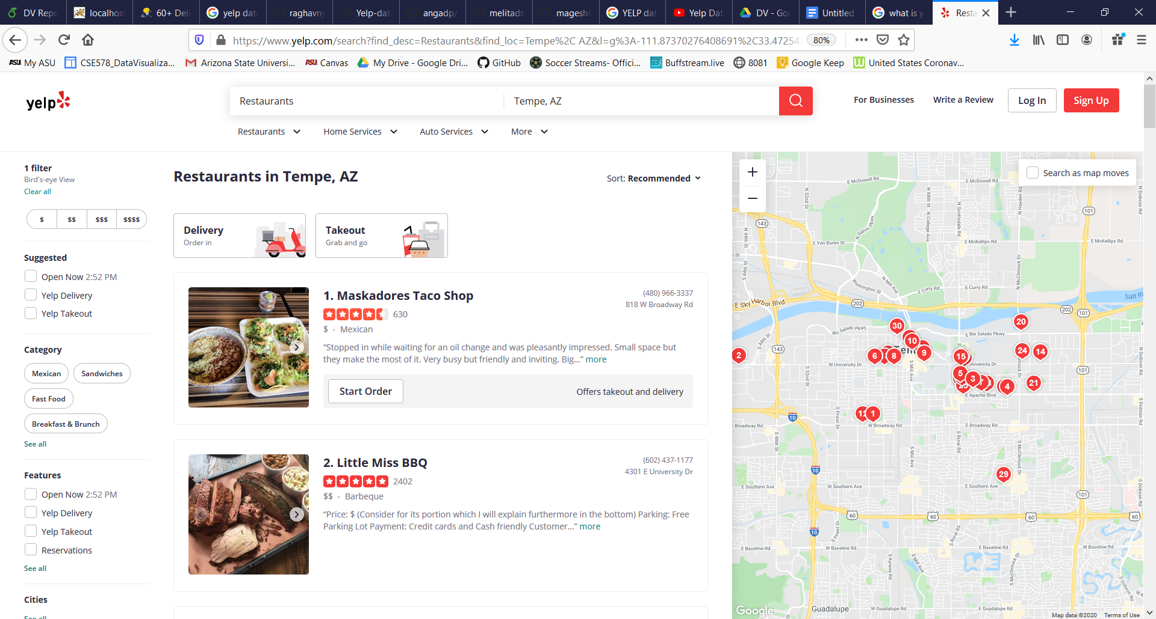
INTRODUCTION
What is Yelp?
Notes:
Yelp is a social networking site that lets users post reviews and rate businesses. The site has pages devoted to individual locations, such as restaurants or schools, where Yelp users can submit a review of their products or services using a one to five-star rating system. Businesses can also update contact information, hours, and other basic listing information or add special deals.
When you go to a new restaurant and have a good experience, it's likely that you won't keep the place a secret.

Slide 3
MOTIVATION
Did you know?
There are more than 1 million restaurants in the US right now [1]
90% of guests check out a restaurant online before going [2]
33% of people read other guests’ reviews before selecting a place to eat [2]
References:
[1] https://www.ibisworld.com/industry-statistics/number-of-businesses/chain-restaurants-united-states/
[2] https://www.smallbizgenius.net/by-the-numbers/restaurant-industry-statistics/gref

Slide 4
GOAL
Create a Visual Recommender System

Slide 5
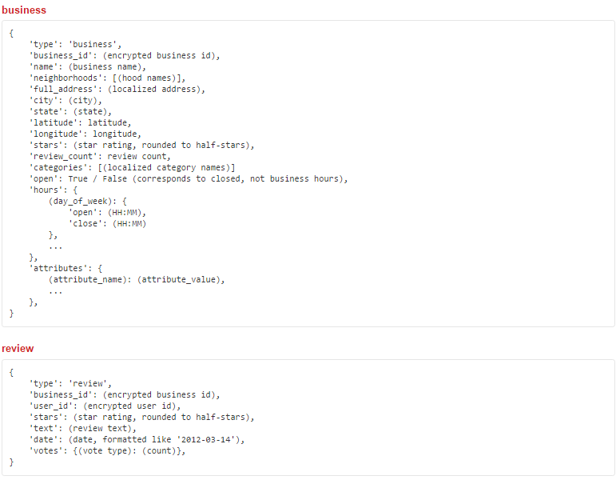
DATASET DESCRIPTION
Data Access: Easily available on yelp https://www.yelp.com/dataset
Data Cleaning
Data Consolidation
Data Reduction
Notes:
Data preparation was really at the heart of our project, before we could do any data exploration we had to get the data into a usable format. To do this we had to follow 4 steps:

Slide 6

Demo

Slide 7
COLOR SCHEME
Unified color scheme
The titles are red, to excite and attract attention.
Visualization lines are green for most part, as green is a happy, soothing, healthy hue.
Bright colors on a white backdrop blend well.

Slide 8
Future Work
More robust recommendation system
Business owner’s perspective
Fake review detection

